Slide 1
{Insert your company name}
FOOTY COLOURS DAY CELEBRATION

Slide 2
COMPETITION TIME CAST YOUR VOTES!
Category 1: Best Footy Colours Day outfit and decorations
Category 2: Best looking footy food and drink

Slide 3
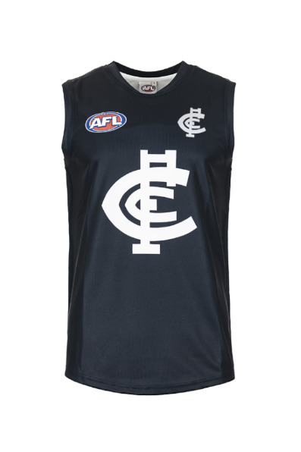
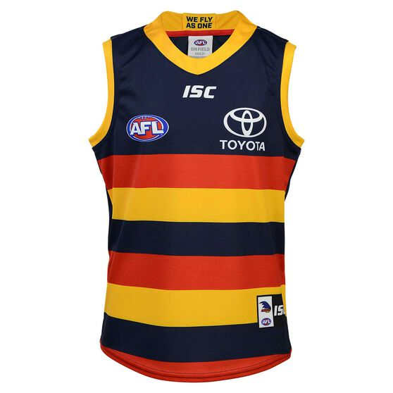
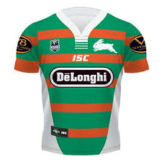
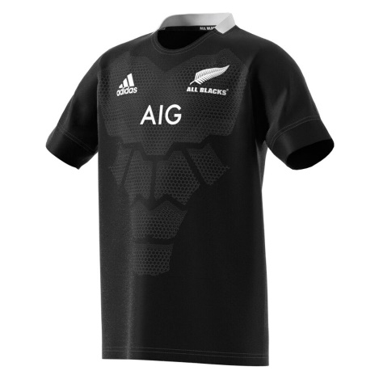
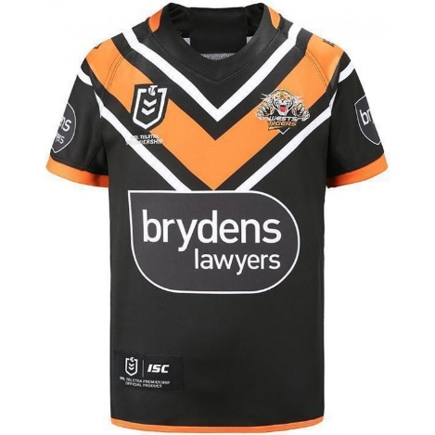
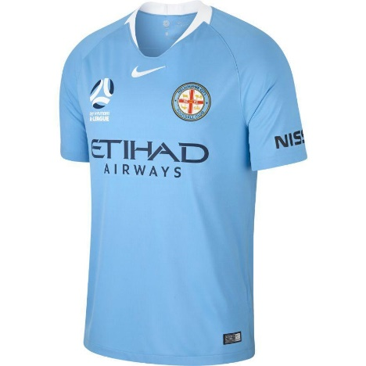
NAME THAT TEAM!
1.
2.
3.
4.
5.
6.

Slide 4
MATCH THE PLAYER TO THEIR TEAM
Adam Treloar
Madison Prespakis
Lance Franklin
Cameron Smith
Samantha Kerr
Dustin Martin
Mitchell Moses
Kezie Apps
Sam Lloyd
Tom Hawkins
Carlton FC
Melbourne Storm
Sydney FC
Geelong FC
Richmond FC
Collingwood FC
St George Illawarra Dragons
Paramatta Eels
Western Bulldogs FC
Chelsea FC

Slide 5
TEST YOUR GENERAL FOOTY KNOWLEDGE
Which country has won the most FIFA world cups?
In rugby union, which of these positions is a back: Hooker, second row or outside centre?
What is the seating capacity of the MCG?
In rugby league, how many points is a converted try worth?
How many players and umpires are on the field during play in an AFL game?
Which two teams play in the State of Origin series?
What medal did the Australia women’s national rugby sevens team win at the 2016 summer Olympics?
How many non-Victorian AFL teams are there?
Who is the Captain on the Australia women’s national soccer team?
Which Major League soccer team was David Beckham playing for when he retired?

Slide 6
FOOTY COLOURS DAY BINGO

Slide 7
T E A M

Slide 8
DON’T FORGET TO DONATE
{insert online fundraising page link here}
All funds raised through Footy Colours Day helps kids with cancer keep up with school!

